Slide 1

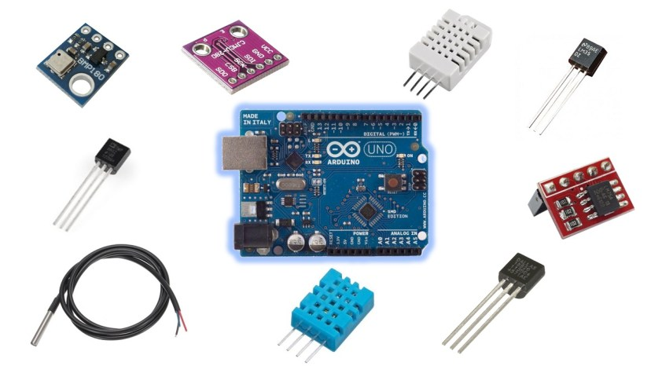
Digital Temperature Sensor
— Yuxi Lu

Slide 2


What are temperature sensors
used to measure?
Determine the temperature
Check the process
Preventative reliability

Slide 3

What is Digital temperature sensor ?
Data conversion and transmission takes place digitally
Components:
Senor
Cable
Transmitter
Directly converted into digital temperature

Slide 4

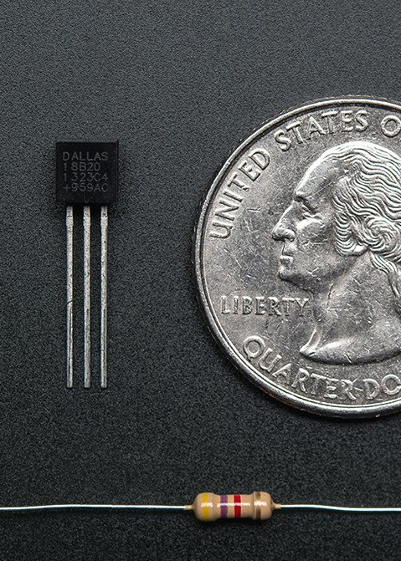
How to Measure Temperature
Voltage difference of the diode terminals
Voltage increases when the temperature rises

Slide 5

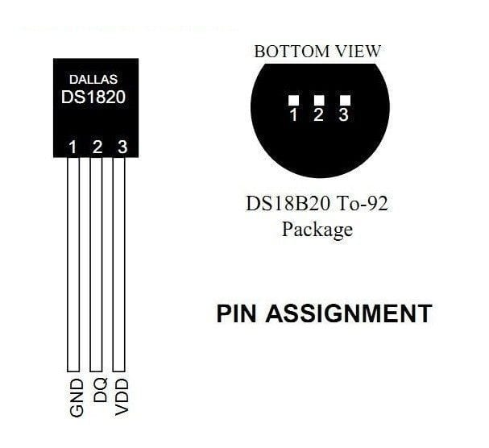
Sensor Features (DS18B20)
Unique 1-Wire Interface
Multidrop Capability
Power supply range ：
3.0V to 5.5V
Operating range temperature ：
-55ºC to 125ºC
Accuracy ：
+/-0.5 ºC
(-10ºC to 85ºC)
Parasitic Power Mode

Slide 6

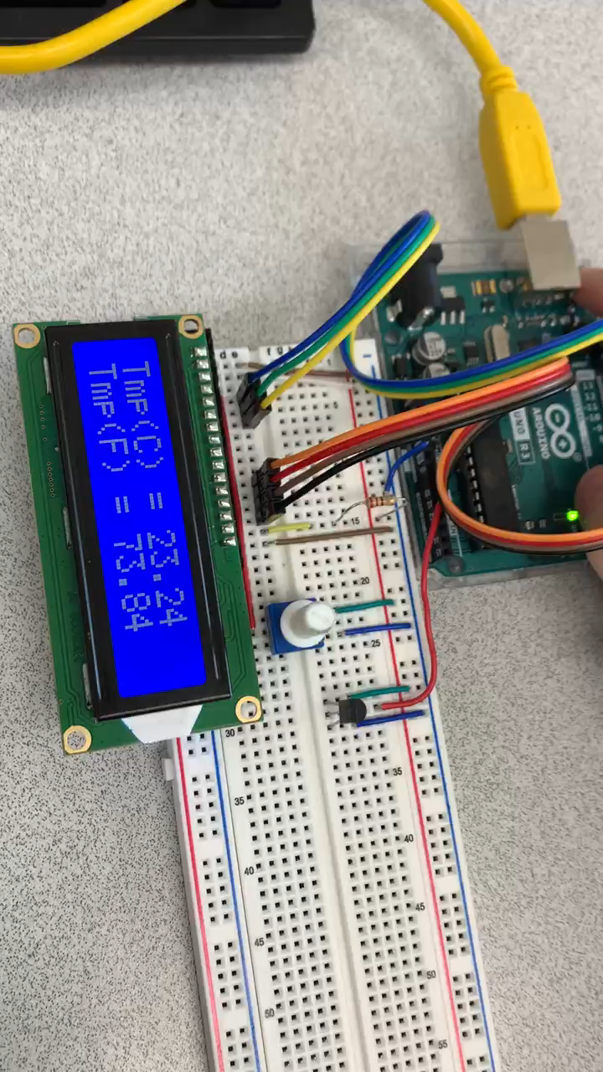
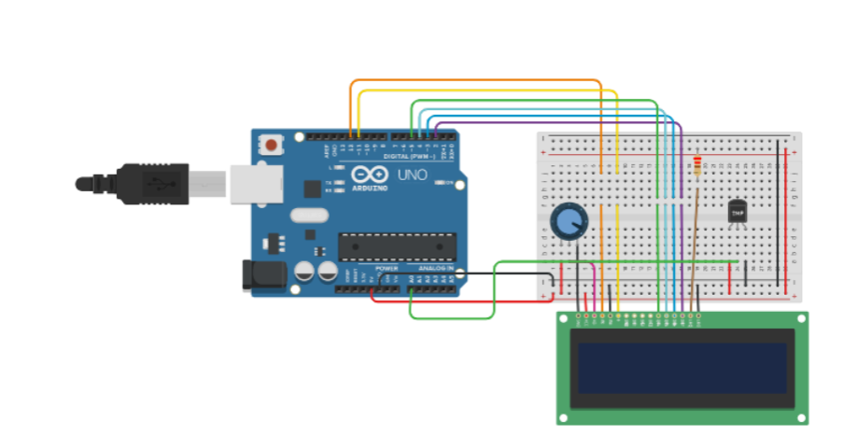

Demonstration

Slide 7

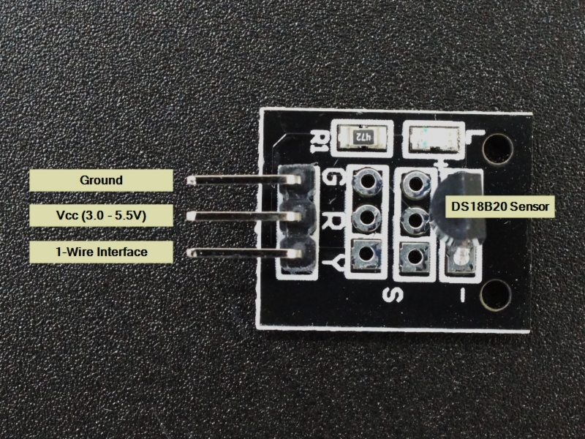
Advantages
High Accuracy
Low Power Consumption
Reduce Component Count
Low Cost

Slide 8

Conclusion
Common applications
Medical applications
Within our homes
Vehicles
Renewable energy
Glass manufacturing
Chemical industries
Integrated circuits
Small Size
Low Hardware Overhead
Strong Anti-interference Ability
High precision

Slide 9
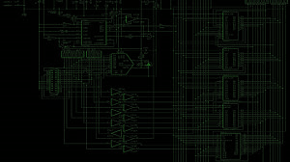
Thanks for Listening !
References
https://randomnerdtutorials.com/9-arduino-compatible-temperature-sensors-for-your-electronics-projects/
https://create.arduino.cc/projecthub/VJZ/lcd-thermometer-using-tmp36-sensor-283186
https://learn.adafruit.com/tmp36-temperature-sensor
https://www.pyrosales.com.au/blog/thermocouple-information/what-are-temperature-sensors-used-for/
https://www.electronicdesign.com/technologies/boards/article/21756038/digital-temperature-sensors
https://www.elprocus.com/temperature-sensors-types-working-operation/

Slide 10
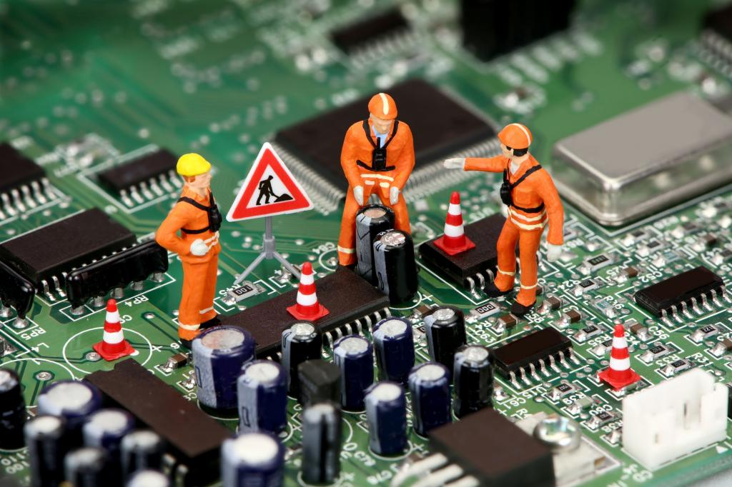
Question ?

